Slide 1
Steganography: Hiding Messages in Images
CAPSTONE PROJECT
Presented By : Himanshu Rajendra Patil
Student Name : Himanshu Patil
College Name & Department : Modern Education Society’s
Wadia College Of Engineering

Slide 2
OUTLINE
Problem Statement
Technology used
Wow factor
End users
Result
Conclusion
Git-hub Link
Future scope

Slide 3
Problem Statement
With increasing digital communication, data security has become crucial. Traditional encryption methods are easily detectable. Steganography offers a solution by hiding secret messages within ordinary images, making the information less suspicious and more secure.

Slide 4
Technology used
Programming Language: Python
Libraries Used:
cv2 (OpenCV) – for image manipulation
os – to handle file operations and CMD interactions
numpy (if applicable) – for efficient image data handling

Slide 5
Wow factors
Unique Features:
Hides messages within images without visibly altering them.
Passcode protection ensures only authorized users can decrypt the message.
Simple, efficient, and runs directly from the Command Prompt with immediate feedback.

Slide 6
End users
Who Can Use This?
Individuals needing secure personal communication.
Organizations looking to safeguard sensitive data.
Journalists or activists in regions with restricted communication freedoms

Slide 7
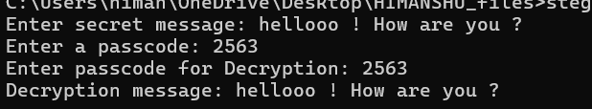
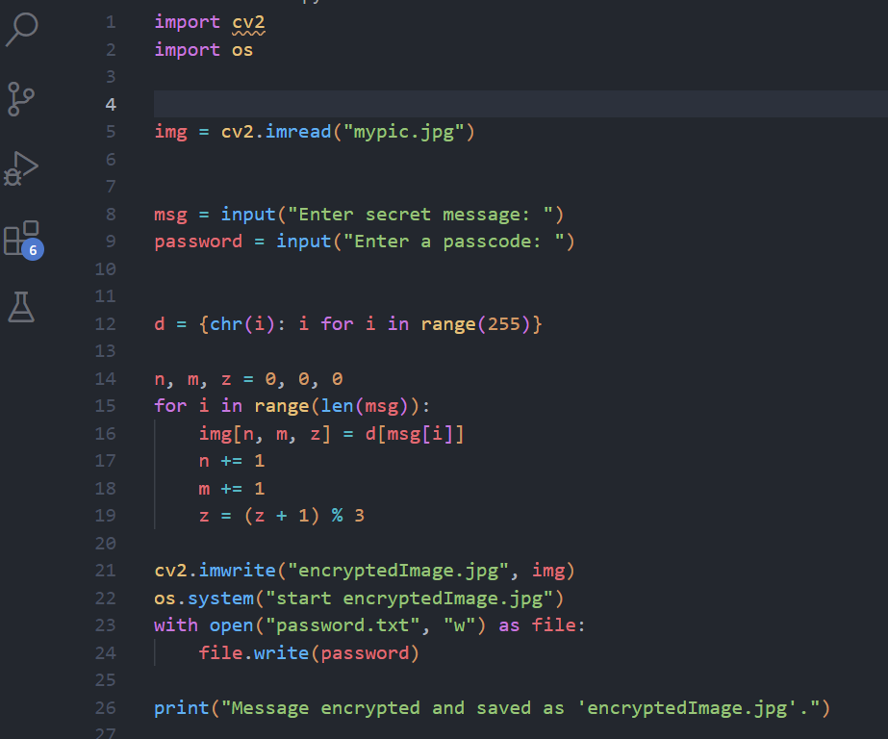
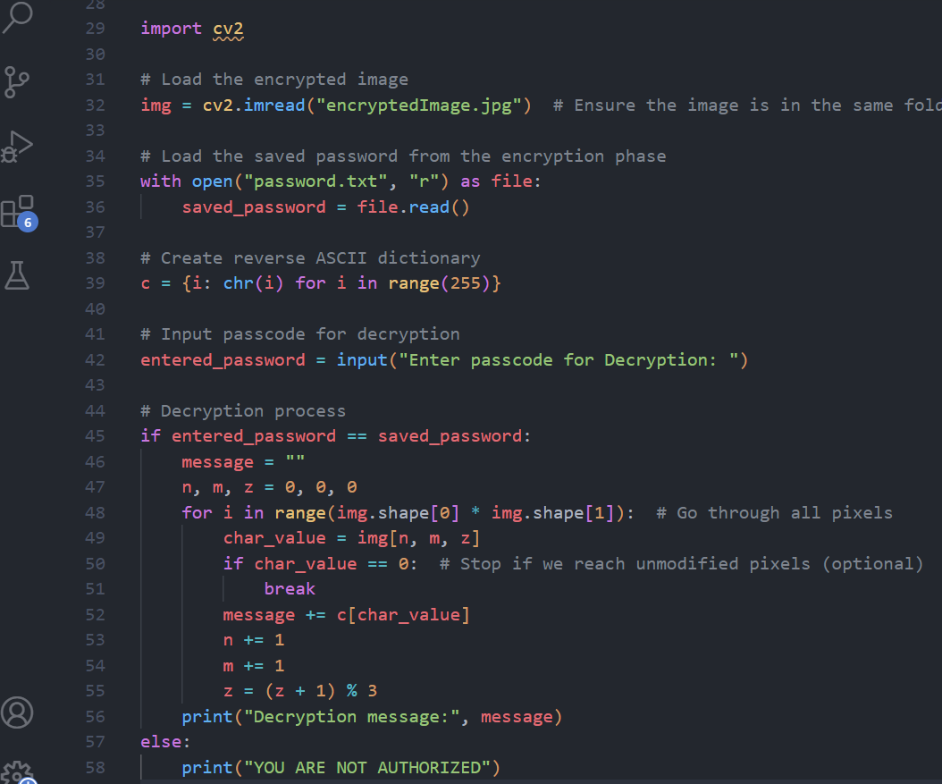
Results OUTPUT : Encrypted code :
DECRYPTED CODE :

Slide 8
Conclusion
This project demonstrates how steganography can be effectively used to enhance data security by embedding messages within images. With passcode protection, the solution ensures that sensitive information remains hidden and accessible only to authorized individuals.

Slide 9
GitHub Link
https://github.com/Hp-27bit

Slide 10
Future scope(optional)
Support for hiding larger files (e.g., documents, audio).
Using advanced encryption algorithms alongside steganography.
Building a GUI-based application for user-friendly interactions

Slide 11
THANK YOU

